Slide 1
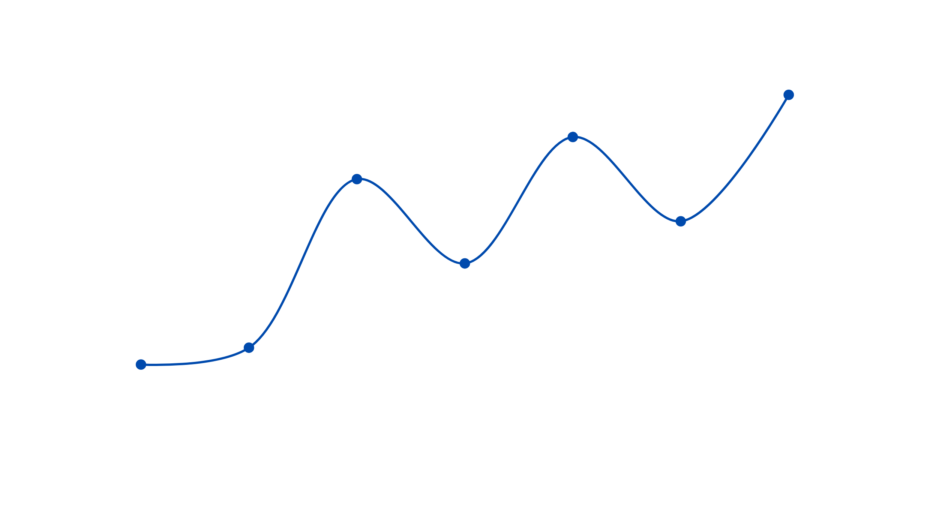

Jun 2025
Mar 2024
2023
+6 MONTHS
Transition
+6 MONTHS
+5 MONTHS
Transition
Transition
Oct 2024
Oct 2023
2013

Slide 2

Jun 2025
Mar 2024
2023
+5 months
transition
+5 months
transition
+5 months
transition
Oct 2024
Oct 2023
2013

